Slide 1
The Happiness Tipping Point
How Happy are the North American Countries?

Slide 2
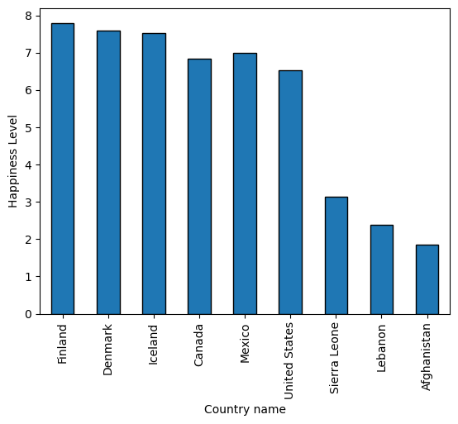
Top, Bottom and Focus Three Happiness

Slide 3
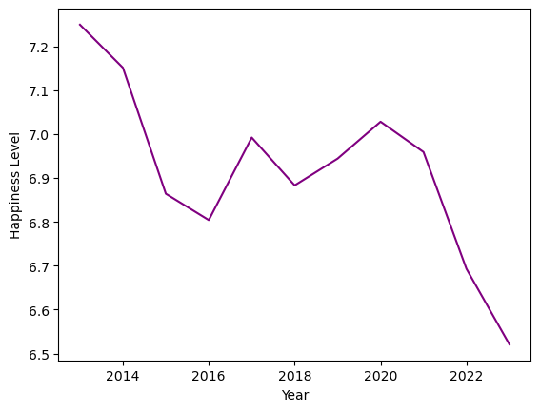
US Happiness

Slide 4
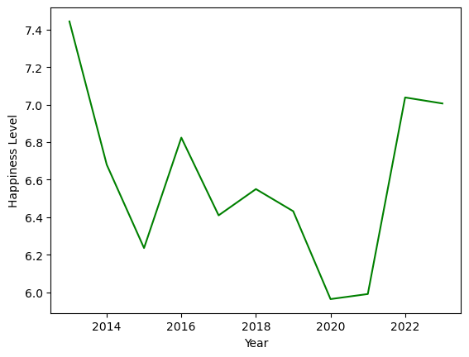
Mexico Happiness

Slide 5
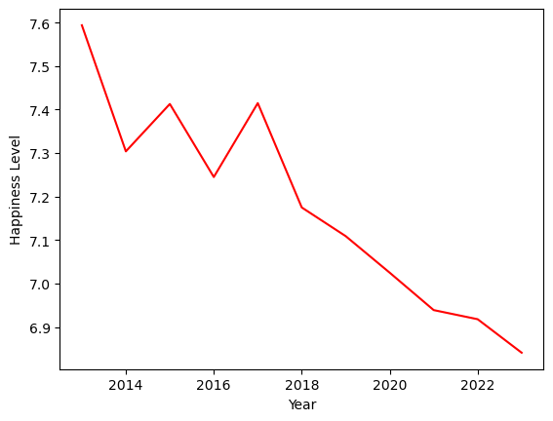
Canada Happiness

Slide 6
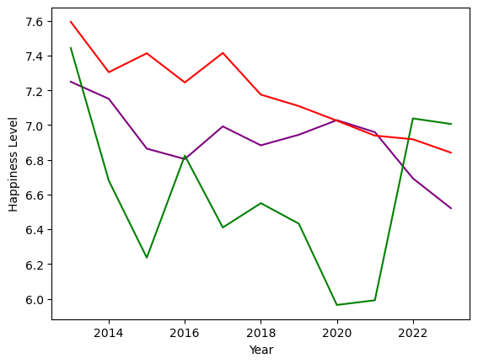
Focus Three Happiness

Slide 7
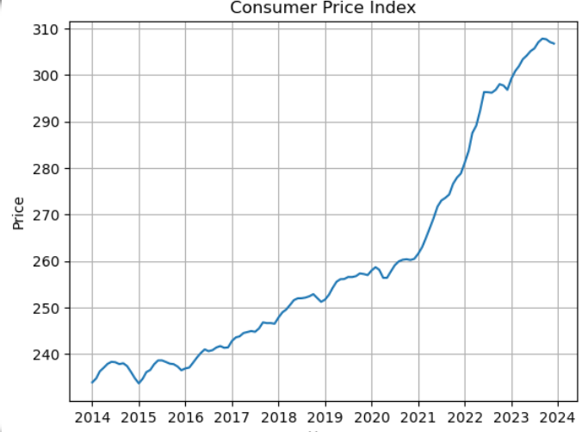
US CPI
US CPI
fffffffffffffffffffffffffffffffffffffffff

Slide 8
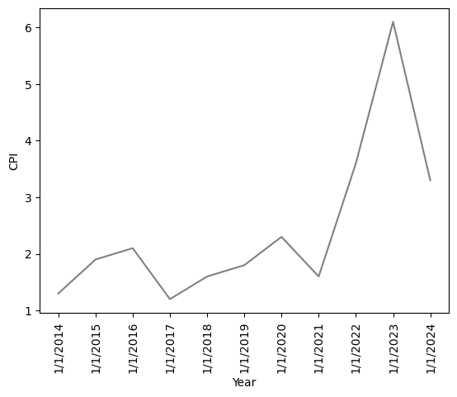
Canada CPI

Slide 9
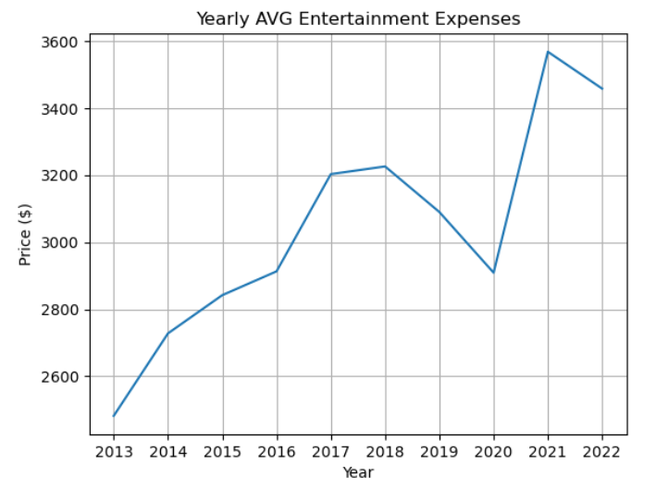
Average Spent on Entertainment
ffffffffffffffffffffffffffffffffffffffffffffffffffffffffffff

Slide 10
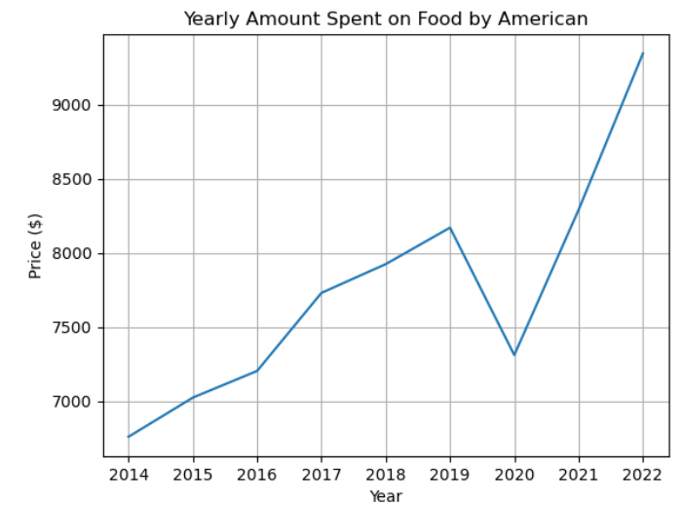
Average Price Spent on Food
ffffffffffffffffffffffffffffffffffffffffffffffffffffffffffffffffff

Slide 11
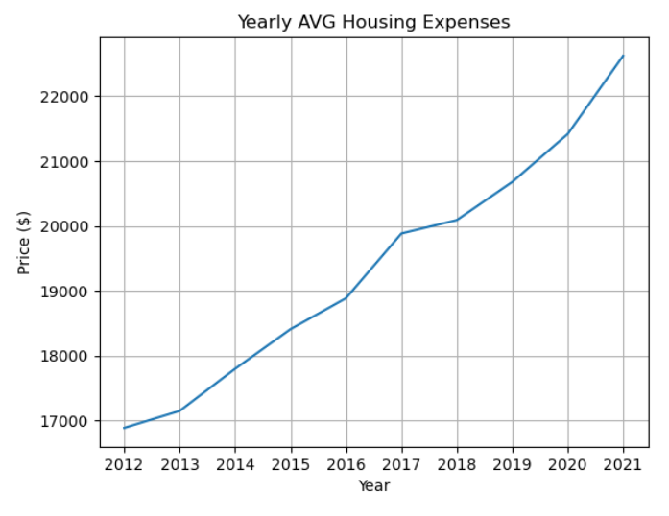
Average Price Spent for Home
ffffffffffffffffffffffffffffffffffffffffffffffffffffffff

Slide 12
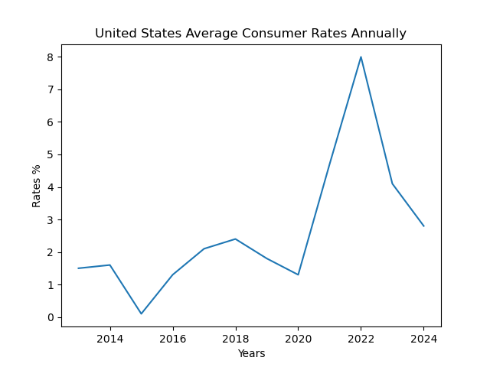
UNITED STATES

Slide 13
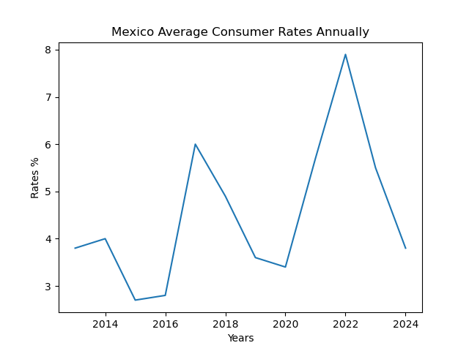
MEXICO

Slide 14
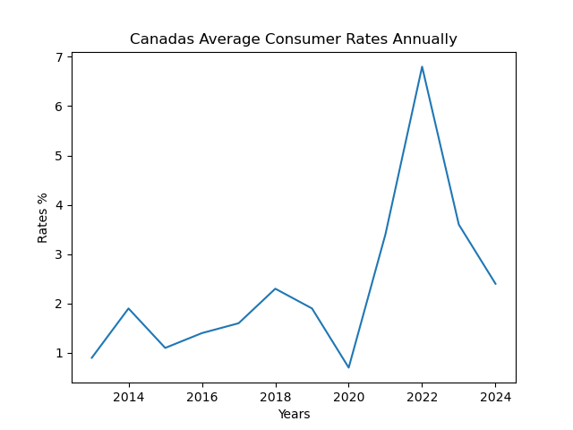
CANADA

Slide 15
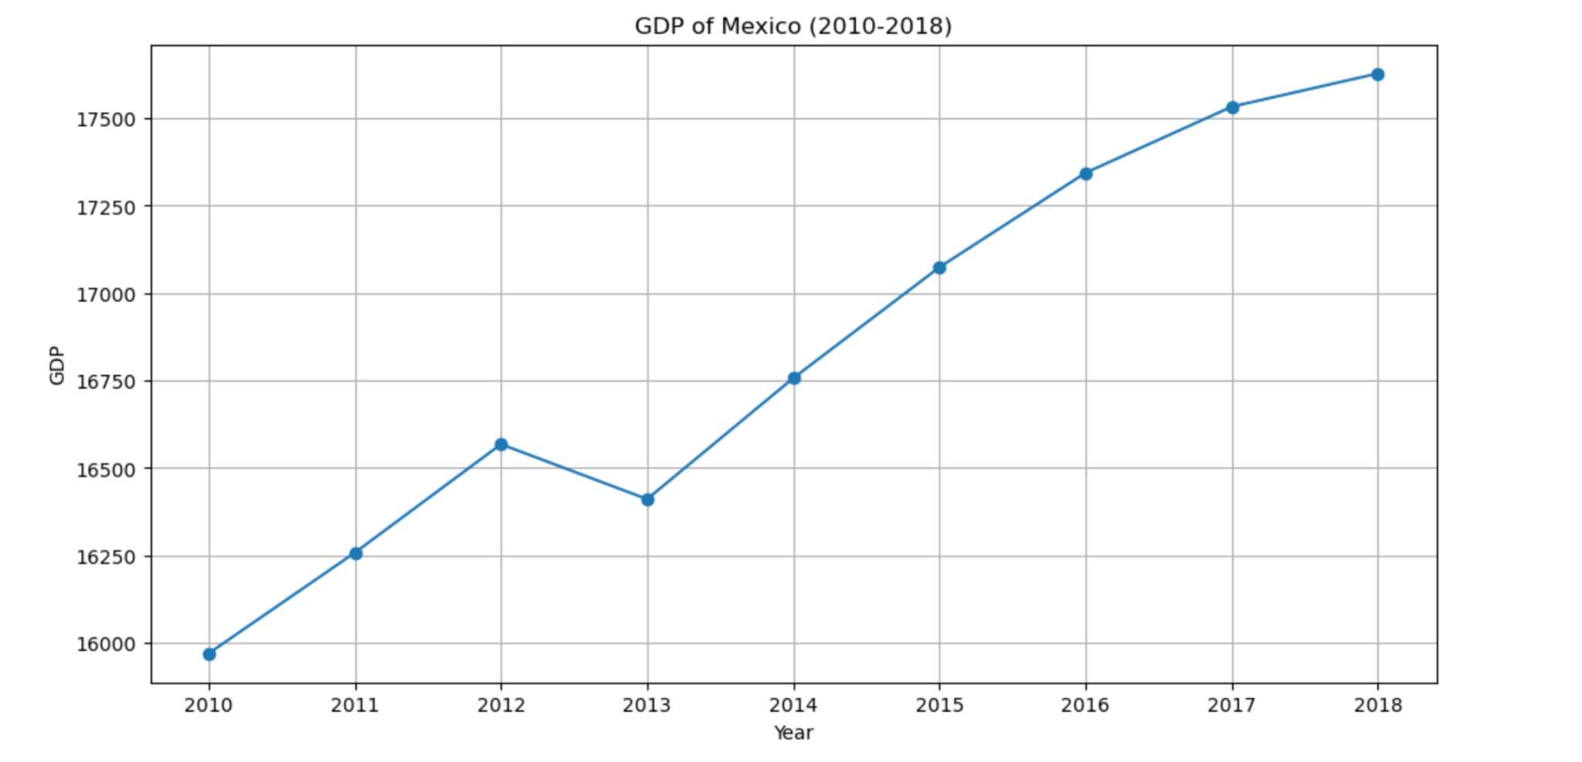
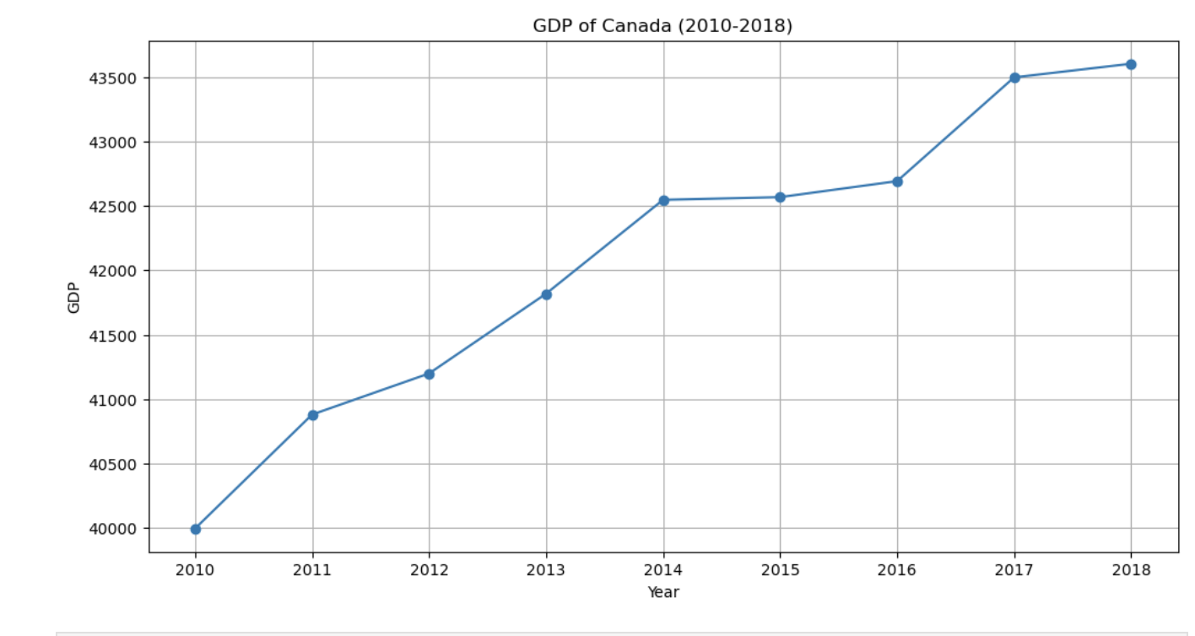
GDP of Mexico and Canada

Slide 16
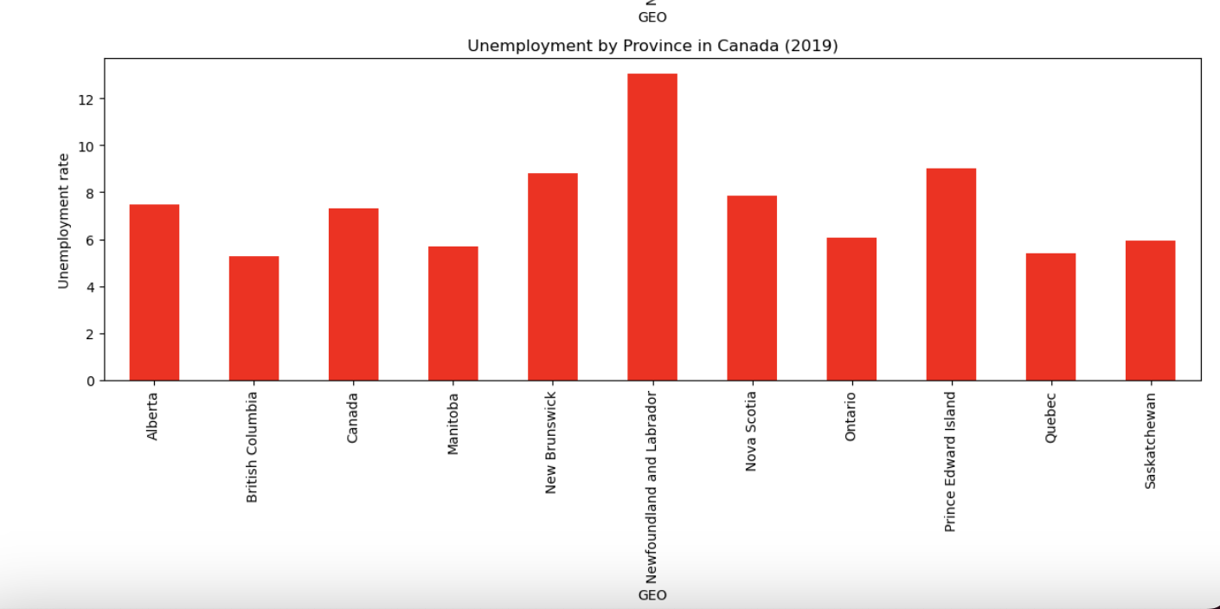
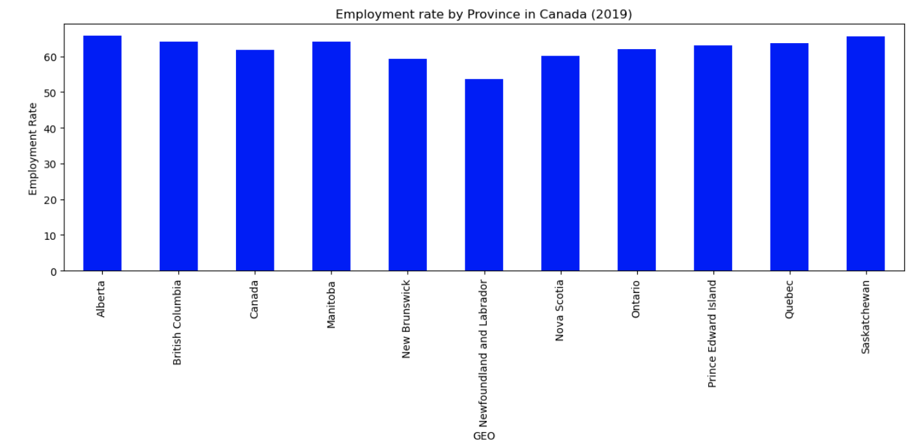
Canada Employment & Unemployment

Slide 17
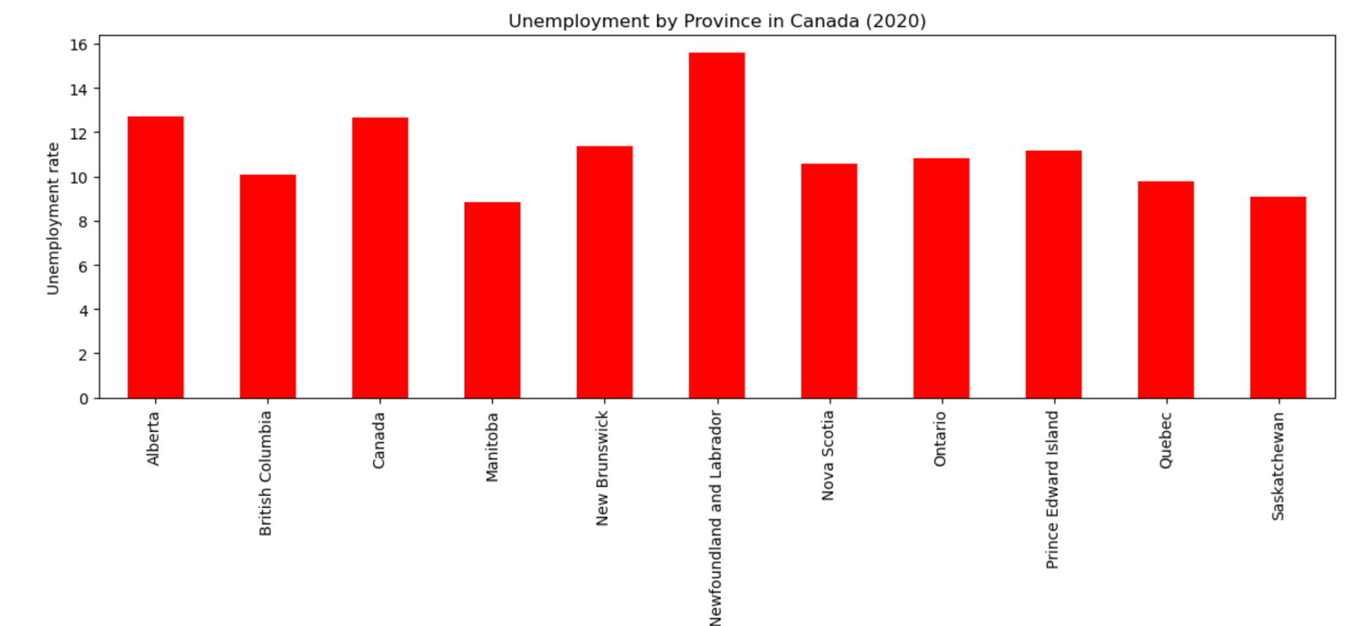
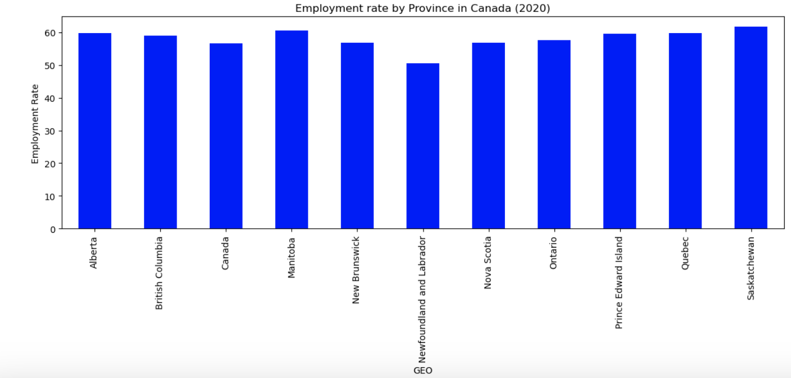
Canada Employment & Unemployment

Slide 18
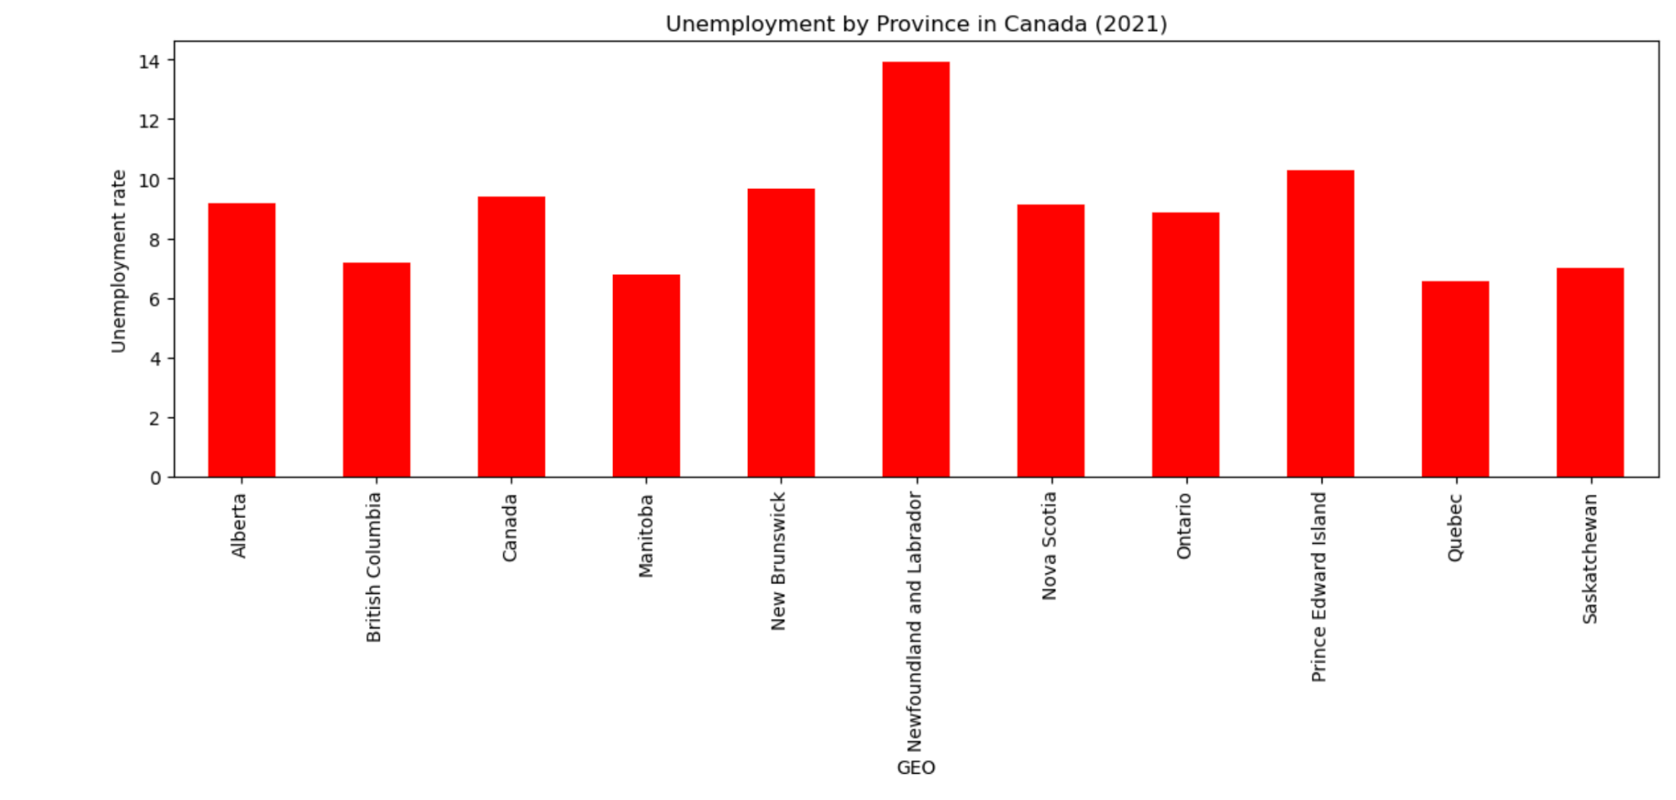
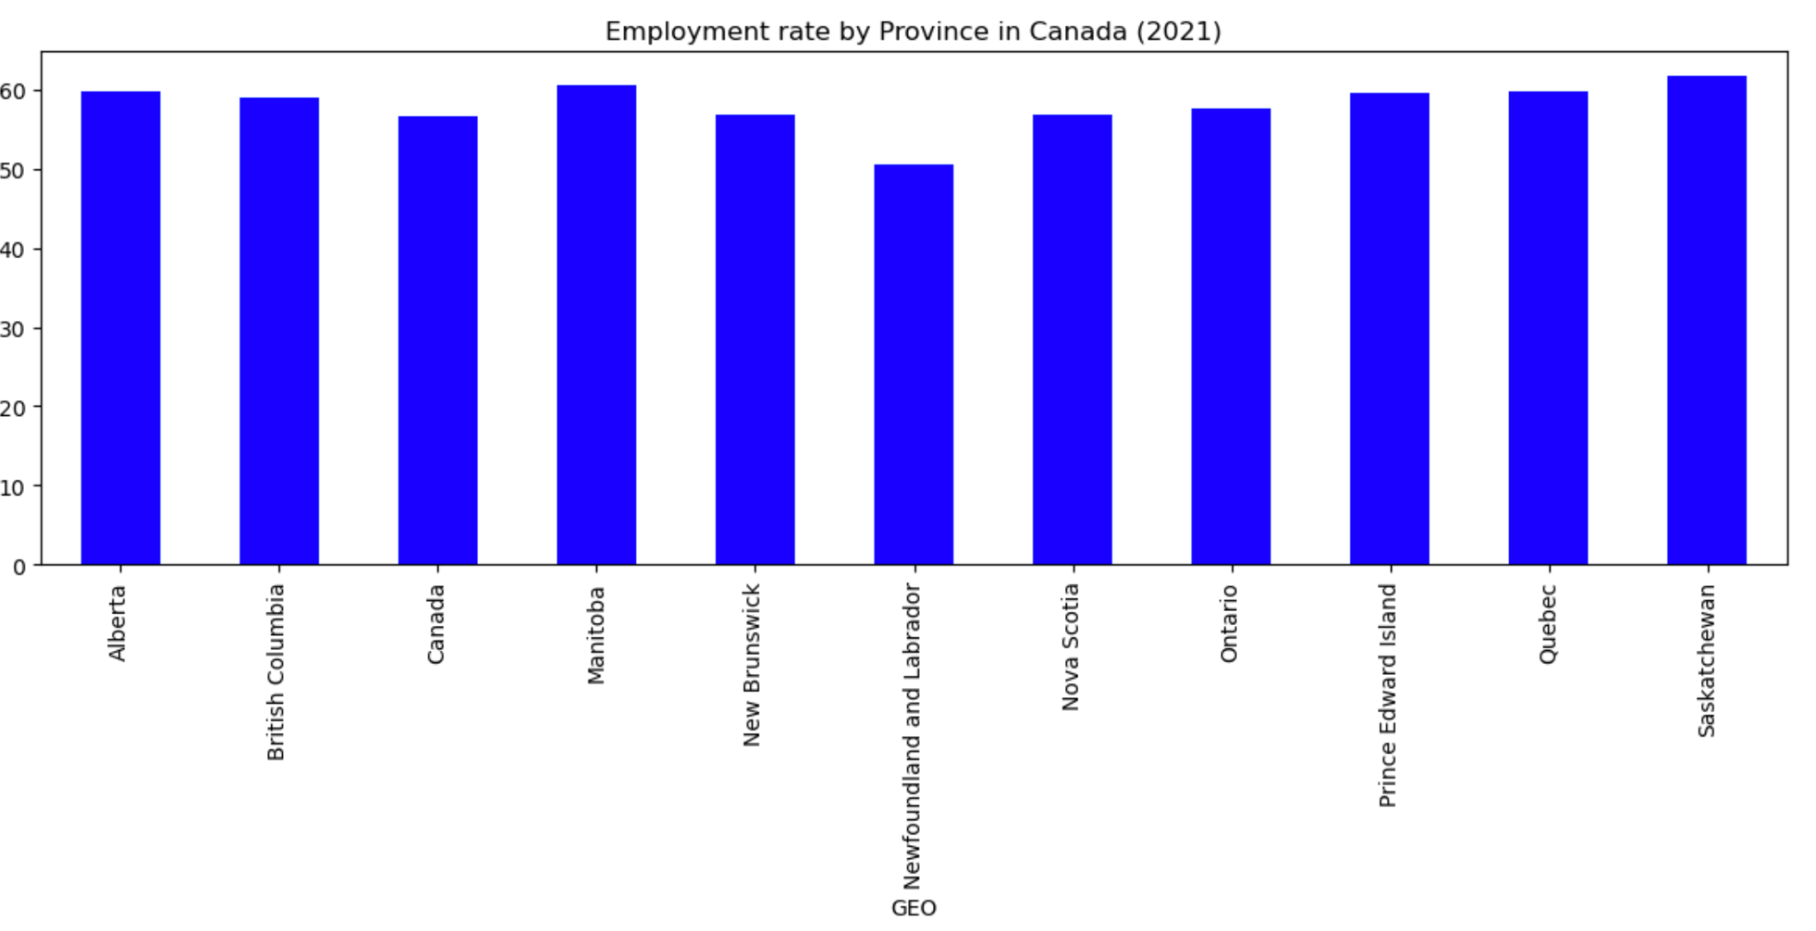
Canada Employment & Unemployment

